Slide 1

Introduction of Java and Computer
Lecture 1

Slide 2
What is Java & why it is so important?
Java is a programming language and computing platform first released by Sun Microsystems in 1995.
There are lots of applications and websites that will not work unless you have Java installed, and more are created every day.
Java is fast, secure, and reliable.
From laptops to datacenters, game consoles to scientific supercomputers, cell phones to the Internet, Java is everywhere!

Slide 3
Why you feel to learn Java?
Here are my couple of reasons why I think Java is the right programming language to start learning to code.
It's Simpler
Java is Easy to Learn: Java is quite easy to learn and can be understood in a short span of time as it has a syntax similar to English
Java has a Large Community: There is a large online community of Java users ranging from beginner, advanced and even expert levels that are particularly helpful in case any support is required.
Java has multiple Open Source Libraries:Open source libraries have resources that can be copied, studied, changed, shared, etc. There are multiple open source libraries in Java such as Maven, Apache Commons, etc
Java is simpler. The syntax is much more readable than C, C++, or any other language.

Slide 4
Why you feel to learn Java?( Cont’d)
Java has Powerful Development Tools : There are many Integrated development environments (IDE’s) in Java that provides various facilities for software development to programmers. Powerful Java IDE’s such as Eclipse, Net Beans, IntelliJ IDEA, etc. play a big role in the success of Java.
Java is Free of Cost : One of the reasons Java is very popular among individual programmers is that it is available under the Oracle Binary Code License (BCL) free of charge. This means that Java is free for development and test environments, but for commercial purposes, a small fee is required.
Java is Platform Independent : Java is platform independent as the Java source code is converted to byte code by the compiler which can then be executed on any platform using the Java Virtual Machine.
Java’s Popularity and High Salary
Java developers are the ones who acquire high paying jobs in the industry. The average Java developer earns around $110,000 per year in the United States. And also best Salary packages in PAKISTAN .its totally depends upon your skills.

Slide 5
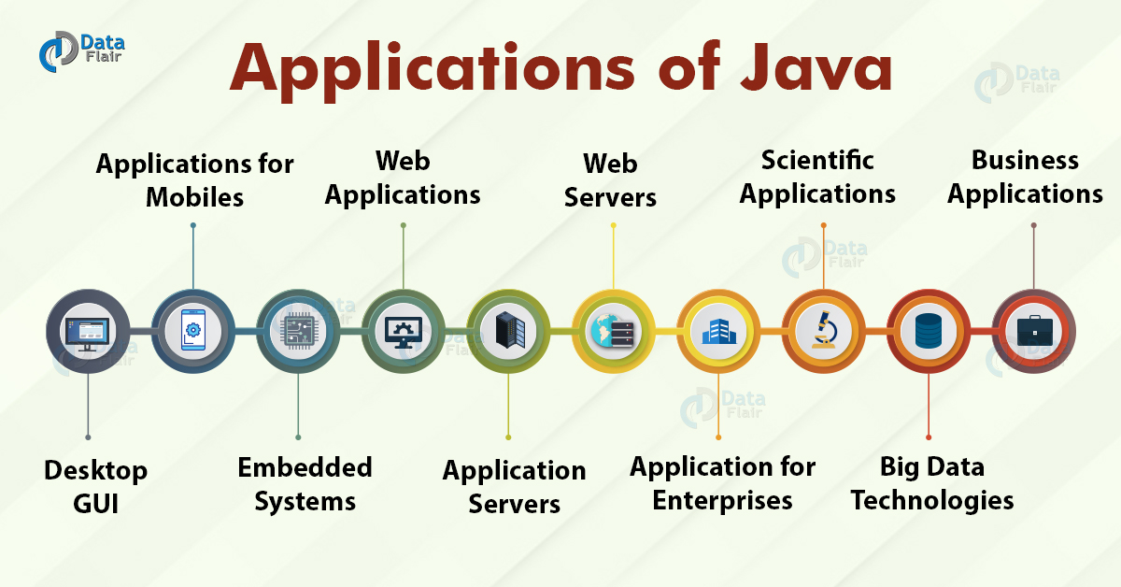
Where Java is Used?

Slide 6
How to learn Java?
If you want to learn Java, be sure you are ready to devote at least 3 to 6months to self-education. Your practicing should be daily or close to this.
The main point: programming is like swimming. It is all about practice. You can’t learn how to swim just by reading a proper book “Swimming for beginners”. You must swim to master it. The same story is with programming.
here are some tips for you of how to learn Java fast:
Set your goals in a career by answering a question “Why exactly do I need Java”.
With this context, create your personal educational plan with a schedule.
Choose tools to help your needs: books, courses, coding platforms, etc.
Find additional sources of information: media, forums, Java communities — everything to keep you up to date.
Practice a lot: you need hundreds of hours of coding before it becomes your habit.
Don’t get stuck on something you don’t quite understand — go on with your study and practice.
Never stop learning: this is what successful programmers do.

Slide 7
What is a Computer?
A computer is a machine that performs computations, logical operations, or more generally, data manipulation according to some prescribed sequence of instructions called a computer program.
The physical components of a computer are termed hardware and the programs software.

Slide 8
The Hardware
The major hardware components:
The central processing unit (CPU)‏
Primary or random access memory (RAM)‏
Secondary or long term memory
Input and output devices (I/O devices)‏

Slide 9
The Central Processing Unit
The CPU does:
the computing
the processing
the majority of the work
Important components of the CPU:
arithmetic and logic unit (ALU)‏
control unit (CU)‏
clock

Slide 10
The Central Processing Unit(CONTD)
The ALU performs calculations, billions per second
The CU controls or coordinates which calculations the ALU performs
The CPU clock determines how frequently the computer hardware executes instructions.
A system’s hardware components are synchronized with the clock. Every time the clock ticks, another hardware action occurs.

Slide 11
Primary or Random Access Memory
How Data is Stored
binary format
a sequence of 0’s and 1's called bits.
ASCII encoding:
‘a’ is represented by 01100001
‘b’ is encoded as 01100010
A sequence of eight bits is called a byte.

Slide 12
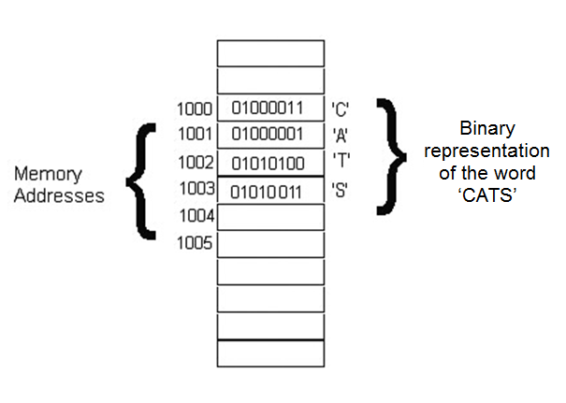
Where Data Is Stored
You can conceptualize RAM as a collection of storage cells or boxes, each capable of holding just a single byte of information.
A unique number, or memory address, identifies each such storage cell.

Slide 13
Input/output Devices
Standard input devices:
keyboards
mouses
joysticks
stylus pens
cameras
microphones
Output devices:
monitors
printers
speakers

Slide 14
The Software
Software is a set of instructions, data or programs used to operate computers and execute specific tasks. Opposite of hardware, which describes the physical aspects of a computer, software is a generic term used to refer to applications, scripts and programs that run on a device.
The programs that run on a computer are collectively known as software. Word processors, internet browsers, editors, database management systems, computer games, and spreadsheets are all part of your computer's software library.
When you turn on or boot your computer, a program called the operating system automatically runs. This special program provides an interface between you and your computer.

Slide 15
Types Of Languages
Procedural Language
In procedural languages, the program code is written as a sequence of instructions. User has to specify “what to do” and also “how to do” (step by step procedure). These instructions are executed in the sequential order. These instructions are written to solve specific problems.
Examples of Procedural languages:
FORTRAN
COBOL
JAVA
C++

Slide 16
Types Of Languages
Non-Procedural Language: In the non-procedural languages, the user has to specify only “what to do” and not “how to do”. It is also known as an applicative or functional language. It involves the development of the functions from other functions to construct more complex functions.
Examples of Non-Procedural languages:
SQL
PROLOG
LISP.

Slide 17
What is Programming Languages?
A programming language is a computer language programmers use to develop
software programs,
scripts
sets of instructions for computers to execute.
OR
like writing a paragraph of instruction or creating a to-do list to computers. Unlike us humans, the to-do list and instructions you write for the computer has to be extremely detailed and written in some logic.

Slide 18
Uses of Programming Languages
Web Development
First, there’s front-end development
which is the part of web development that creates the application that runs on your browser and adjusts the styling, the colors, the interactions. Front-end basics start with HTML and CSS with use of JavaScript Angular & React etc.
Secondly , there’s backend-end development
which is related to the server, the computer that runs the website software and serves it to the world. It’s mostly concerned with routing, which pages to deliver to the user when they visit a certain URL, it also communicates with the database that stores the website’s information and sends this data over to the user.
Java ,Php or Python etc.

Slide 19
Uses of Programming Languages continue
Mobile Development
The most two common operating systems are Android and IOS. Android is most commonly used in Samsung while IOS is used in Apple. To create Android apps, you’d need either Java or Kotlin, and for creating IOS applications you’d need Objective-C or Swift. Recently, it became possible to create mobile applications for both Android and IOS using JavaScript or Dart.

Slide 20
Programming Languages Types
Machine languages
Assembly languages
High-level languages

Slide 21
Machine languages
Machine language is a set of primitive instructions built into every computer. The instructions are in the form of binary code, so you have to enter binary codes for various instructions. Program with native machine language is a tedious process. Moreover the programs are highly difficult to read and modify. For example, to add two numbers, you might write an instruction in binary like this:
1101101010011010

Slide 22
Assembly languages
Assembly languages were developed to make programming easy. Since the computer cannot understand assembly language, however, a program called assembler is used to convert assembly language programs into machine code. For example, to add two numbers, you might write an instruction in assembly code like this:
ADDF3 R1, R2, R3

Slide 23
High-level languages
The high-level languages are English-like and easy to learn and program. For example, the following is a high-level language statement that adds two numbers:
total = 3 + 4;

Slide 24
Thank You For Today
Class

